Slide 1

Subtopic N2.12 – Perimeter of an Isosceles Triangle or an Isosceles Trapezium
LEARNING OUTCOME: To solve problems involving the perimeter of an isosceles triangle or an isosceles trapezium
Keywords:
Triangle
Trapezium
Isosceles
Perimeter
Objectives:
To recognise an isosceles triangle and an isosceles trapezium
To find the perimeter of an isosceles triangle or an isosceles trapezium
To find missing lengths in an isosceles triangle or an isosceles trapezium
Introduction – Read and annotate:
An isosceles triangle has two sides that are equal in length and an isosceles trapezium has a pair of
equal non-parallel sides. In this subtopic, you will use your knowledge of perimeter and apply it to
find the perimeter of these two types of shape. Sometimes, you will be given isosceles triangles and
isosceles trapeziums where some side lengths are missing. You will need to use these facts to find
the missing sides, before adding to get the perimeter.
Definition
Characteristics
7
As isosceles triangle is a triangle that has two sides of equal length.
An isosceles trapezium is a trapezium where the two non-parallel sides are of equal length
In an isosceles triangle there are also two angle of equal size.
In an isosceles trapezium there are two pairs of equal angles.
Both an isosceles triangle and an isosceles trapezium have one line of symmetry
Examples
3cm
Isosceles Triangles and Trapeziums
Non - Examples
3cm
5cm
6cm
4cm
2cm
2cm
6cm
5cm
5cm
2cm
2cm
3cm
2cm
4cm
7cm
5cm
3cm
4cm
9cm
Recognise an isosceles triangle or an isosceles trapezium
Example 1 - I do…
Example 2 – We do…
Example 3 – You do…
Steps | Circle the isosceles triangle and isosceles trapezium | Circle the isosceles triangle and isosceles trapezium | Circle the isosceles triangle and isosceles trapezium
Count the number of equal sides
For a trapezium, check the equal sides are opposite each other

Slide 2
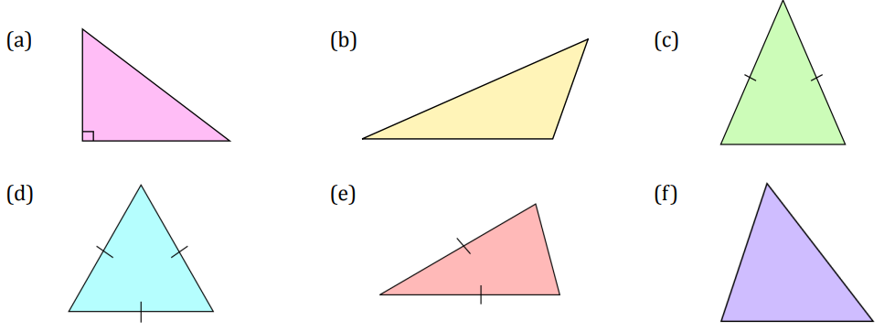
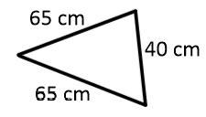
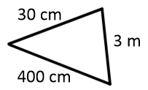


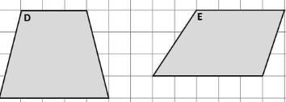
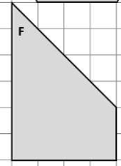
Independent Practice
1. Which of these are isosceles triangles?
(g)
(h)
2. Which of these are isosceles trapeziums?
Find the perimeter of an isosceles triangle or an isosceles trapezium
Example 4 - I do…
Example 5 – We do…
Example 6 – You do…
Steps | Calculate the perimeter | Calculate the perimeter | Calculate the perimeter
1) Fill in the missing side lengths 2) Add up the side lengths
4cm
7.5cm
5cm
2cm
2.5cm
4cm
10cm
17.5cm
14cm
2cm
3cm
4cm
4cm
6.2cm
6cm
5cm
6cm
8.4cm
7cm
16cm
23.8cm
21cm

Slide 3
Independent Practice
3. Calculate the perimeter
a) b) c) d)
e) f) g) h)
4. The lengths in an isosceles trapezium are 3.2 cm, 4 cm and 5.8 cm.
Sketch three different possibilities for the trapezium and find their perimeters.
Option 1: Option 2: Option 3:
Perimeter = Perimeter = Perimeter =
3m
30mm
5cm
3.5cm
6m
6.5cm
60mm
2cm
12cm
15m
16.5cm
150mm
3cm
5.5cm
40mm
35mm
2cm
8m
5m
4.2cm
4.6cm
3cm
8cm
5cm
3.5cm
3m
12cm
19m
18.2cm
190mm
4cm
3.2cm
3.2cm
3.2cm
4cm
5.8cm
5.8cm
5.8cm
4cm
16.2cm
17cm
18.8cm
Find missing lengths in an isosceles triangle or an isosceles trapezium
Example 7 - I do…
Example 8 – We do…
Example 9 – You do…
Steps | Calculate x | Calculate x | Calculate x
1) Subtract known side lengths from the perimeter 2) Divide as necessary to find missing side lengths
Perimeter = 15cm
Perimeter = 20cm
Perimeter = 30cm
x
8cm
x
3cm
x
8cm
6cm
4cm
11cm

Slide 4
Example 10 - I do…
Example 11 – We do…
Example 12 – You do…
Steps | Calculate x | Calculate x | Calculate x
1) Subtract known side lengths from the perimeter 2) Divide as necessary to find missing side lengths
Perimeter = 15cm
Perimeter = 25cm
Perimeter = 30cm
2cm
4cm
5cm
x
6cm
x
5cm
x
7cm
4cm
9cm
9cm
Independent Practice
5. Work out x
a) Perimeter = 20cm
b) Perimeter = 24m
c) Perimeter = 30cm
d) Perimeter = 35cm
x
3.5cm
x
6m
x
x
50mm
4cm
8cm
9cm
13.25cm
15cm
e) Perimeter = 20cm
f) Perimeter = 24m
g) Perimeter = 30cm
h) Perimeter = 35cm
5cm
4m
7.5cm
x
x
80mm
40mm
7cm
x
9cm
4.5cm
x
3cm
6.5cm
9cm
11.5cm
6. An isosceles triangle has a side with length 10.3 cm. Its perimeter is 45 cm. Sketch two different possibilities for the triangle, labelling the lengths of all the sides
10.3cm
17.35cm
24.4cm
10.3cm

Slide 5
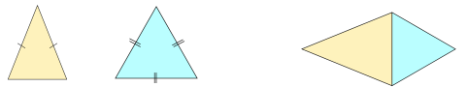
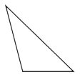
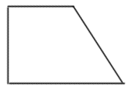
7. An isosceles triangle has a perimeter of 73cm. An equilateral triangle has a perimeter of 51cm. The triangles are put together to make a kite. Work out the perimeter of the kite.
28 + 28 + 17 + 17 = 90cm
8.
Triangle ABC is isosceles. The length of side AB is 6cm. The perimeter of the triangle is 17cm. What is the length of BC?
A
5cm
B
C
9.
The perimeter of this triangle is 14cm.
Find two possible values for x and y
x = 5cm, y = 4cm
x = 3.5cm, y = 7cm
2x + y = 14
x
y
10.
ABCD is a trapezium. AD is 5cm. DC is twice
as long as AB. The perimeter is 31cm. What
Is the length of AB?
A
B
D
C
7cm
11.
Triangles ABD and BCD are both isosceles.
The perimeter of triangle ABD is 19cm and
The perimeter of triangle BCD is 13cm. BD
is 5cm. What is the perimeter of the shape
ABCD?
B
A
C
D
22cm
Skills Check
1. Which is the isosceles shape?
2. What is the perimeter of the triangle?
8.5cm
A 14cm
B 17cm
A
B
C
D
C 22.5cm
D 28cm
5.5cm
3. What is the perimeter of the trapezium?
4. The perimeter of the triangle is 30cm.
What is the missing length x?
9mm
10mm
x
15mm
8cm
A 44mm
B 35.9mm
C 34mm
D 25.9mm
A 22cm
B 11cm
C 38cm
D 68cm

